Slide 1
ONLINE LEAVE MANAGEMENT SYSTEM
BY
RINSIYA RASMIN R V
GUIDED BY
MRS.PRIYA J D
ASSISTANT PROFESSOR
MASTER OF COMPUTR APPLICATIONS
MES COLLEGE OF ENGINEERING,KUTTIPURAM

Slide 2
CONTENTS
Overview
Modules
Product Backlog
User Story
Project Plan
Sprint
DFD
E R Diagram
Developing Environment

Slide 3
OVERVIEW
Online Leave Management System is a web based application that is developed using PHP and MySQL.
Online Leave Management System is to develop a web based application using which management of leave application and approval is done online.
It gives the freedom to apply, approve, reject and manage leave requests from any place, any time and from any device.
Faculty member of the institute can apply for leave directly from this application.
First HOD of their respective department can grant the leave application and then ADMIN can also grant it.
Leave is granted based on the remaining days of leave that a staffs have.

Slide 4
OVERVIEW
ADMIN can add, update and delete leave type(includes casual leave, medical leave, half pay leave and etc) and departments, add an staff and also update the staff information, manage the leave application and change own password after login.
HOD can also add an staff and update the information, manage leave application and change own password after login.
STAFF login with a valid email and password and can update his/her profile, apply for leave and view leave history

Slide 5
Modules
1)Admin:
Login
Manage Leave type
Manage Department
Manage Staff and information
Manage Leave
Manage Profile
View Leave Status
2)HOD:
Login
Manage Staff and information
Manage Leave
Manage Profile
View Leave Status
3)Faculty:
Login
Manage Profile
View Leave Status
Apply Leave Application

Slide 6
PRODUCT BACKLOG
ID | PRIORITY | SIZE (Hours) | SPRINT | STATUS | NAME
1 | Medium | 3 | 1 | completed | Registraton
2 | Medium | 1 |  | completed | Login
3 | High | 4 | 2 | completed | Table Design
4 | High | 23 |  | completed | Coding
5 | Medium | 4 | 3 | completed | Testing Data
6 | High | 6 |  | completed | Output Generation

Slide 7
PROJECT PLAN
ID | TASK NAME | START DATE | END DATE | PROJECT HOURS | STATUS
1 | Sprint 1 | 15/09/2023 | 12/10/2023 | 13 | completed
2 | Sprint 2 | 13/10/2023 | 03/11/2023 | 14 | completed
3 | Sprint 3 | 08/11/2023 | 30/11/2023 | 14 | completed

Slide 8
User Story
Story ID | As a<Type of user> | I want to | So that i can
1 | Admin | login | login successfully
2 | Admin | manage | leave type, leave, department, profile, staff and info
3 | Admin | view | leave status
4 | HOD | login | login successfully
5 | HOD | manage | leave, department, profile, staff and info
6 | HOD | view | leave status

Slide 9
User Story
Story ID | As a<Type of user> | I want to | So that i can
7 | Faculty | login | login successfully
8 | Faculty | manage | Profile
9 | Faculty | view | leave status
10 | Faculty | apply | leave

Slide 10
SPRINT PLAN
SPRINT 1
Backlog Item | Status and Completion date | Original Estimate in hours | Day 1 15/09 | Day 2 20/09 | Day 3 21/09 | Day 4 28/09 | Day 5 29/09 | Day 6 04/10 | Day 7 05/10 | Day 8 06/10 | Day 9 11/10 | Day10 12/10
Form Design | 15/09/2023 | 2 | 2 | 0 | 0 | 0 | 0 | 0 | 0 | 0 | 0 | 0
Table Design | 28/09/2023 | 3 | 0 | 1 | 1 | 1 | 0 | 0 | 0 | 0 | 0 | 0
Coding | 06/10/2023 | 6 | 0 | 0 | 0 | 0 | 2 | 1 | 1 | 2 | 0 | 0
Testing & Validation | 12/10/2023 | 2 | 0 | 0 | 0 | 0 | 0 | 0 | 0 | 0 | 1 | 1
Total |  | 13 | 2 | 1 | 1 | 1 | 2 | 1 | 1 | 2 | 1 | 1

Slide 11
SPRINT PLAN
SPRINT 2
Backlog Item | Status and Completion date | Original Estimate in hours | Day 1 13/10 | Day 2 18/10 | Day 3 19/10 | Day 4 20/10 | Day 5 25/10 | Day 6 26/10 | Day 7 27/10 | Day 8 01/11 | Day 9 02/11 | Day 10 03/11
Form Design | 13/10/2023 | 2 | 2 | 0 | 0 | 0 | 0 | 0 | 0 | 0 | 0 | 0
Table Design | 18/10/2023 | 1 | 0 | 1 | 0 | 0 | 0 | 0 | 0 | 0 | 0 | 0
Coding | 01/11/2023 | 8 | 0 | 0 | 1 | 2 | 1 | 1 | 2 | 1 | 0 | 0
Testing & Validation | 03/11/2023 | 3 | 0 | 0 | 0 | 0 | 0 | 0 | 0 | 0 | 1 | 2
Total |  | 14 | 2 | 1 | 1 | 2 | 1 | 1 | 2 | 1 | 1 | 2

Slide 12
SPRINT PLAN
SPRINT 3
Backlog Item | Status and Completion date | Original Estimate in hours | Day 1 08/11 | Day 2 09/11 | Day 3 10/11 | Day 4 15/11 | Day 5 16/11 | Day 6 17/11 | Day 7 22/11 | Day 8 23/11 | Day 9 24/11 | Day 10 29/11 | Day 11 30/11
Coding | 01/11/2023 | 9 | 1 | 1 | 2 | 1 | 1 | 2 | 1 | 0 | 0 | 0 | 0
Testing & Validation | 30/11/2023 | 5 | 0 | 0 | 0 | 0 | 0 | 0 | 0 | 1 | 2 | 1 | 1
Total |  | 14 | 1 | 1 | 2 | 1 | 1 | 2 | 1 | 1 | 2 | 1 | 1

Slide 13
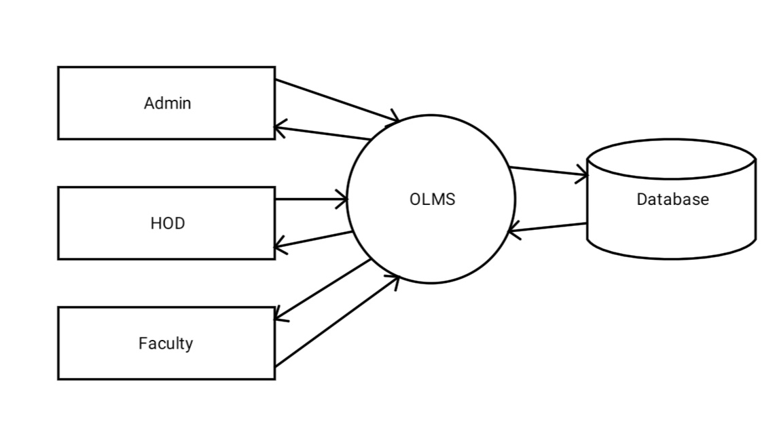
DFD
Level 0

Slide 14
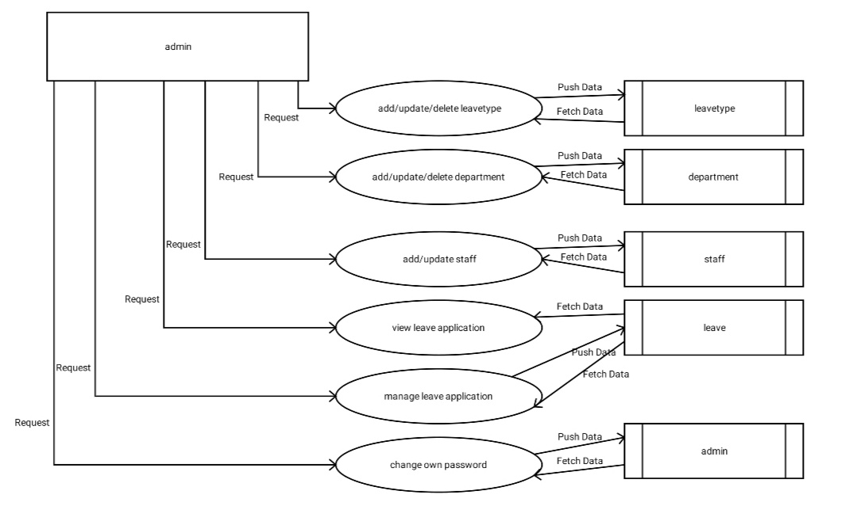
Level 1:1.1 Admin

Slide 15
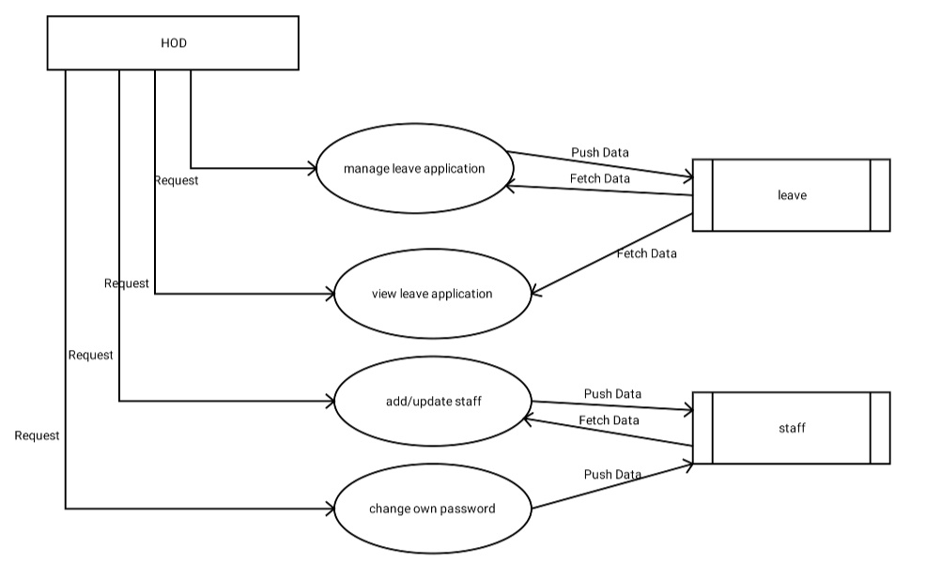
Level 1:1.2 HOD

Slide 16
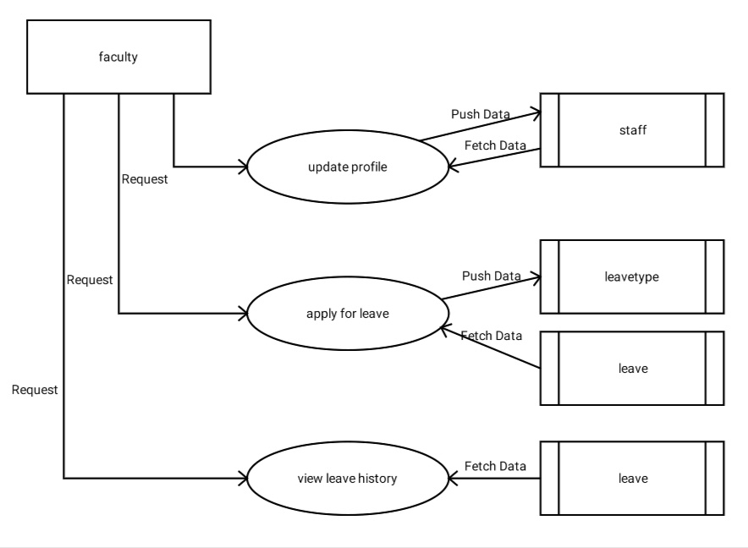
Level 1:1.3 Faculty

Slide 17
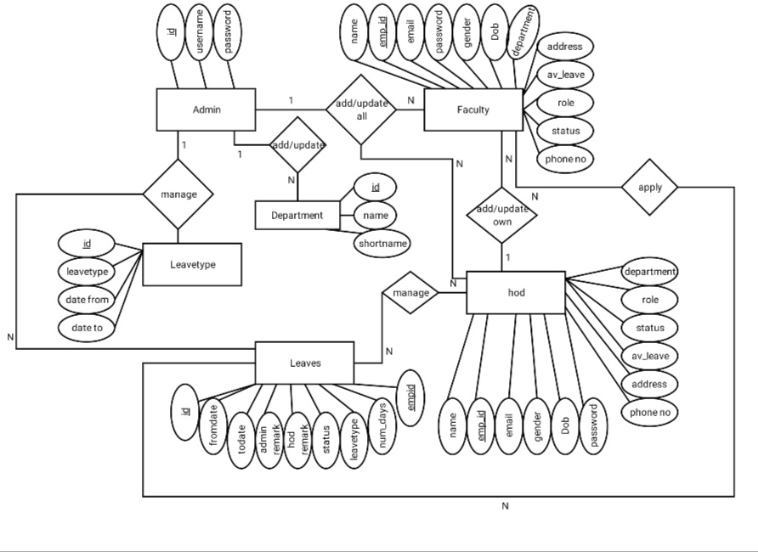
E R DIAGRAM

Slide 18
Developing Environment
SOFTWARE SPECIFICATION
Front end: HTML, CSS, JavaScript
Back end: PHP, MySQL
HARDWARE SPECIFICATION
Processor: Intel core i3 or above
Hard Disk: 20GB
RAM: Minimum 2GB

Slide 19
Thank you

